Slide 1
Sales Performance of Dashboard

Slide 2
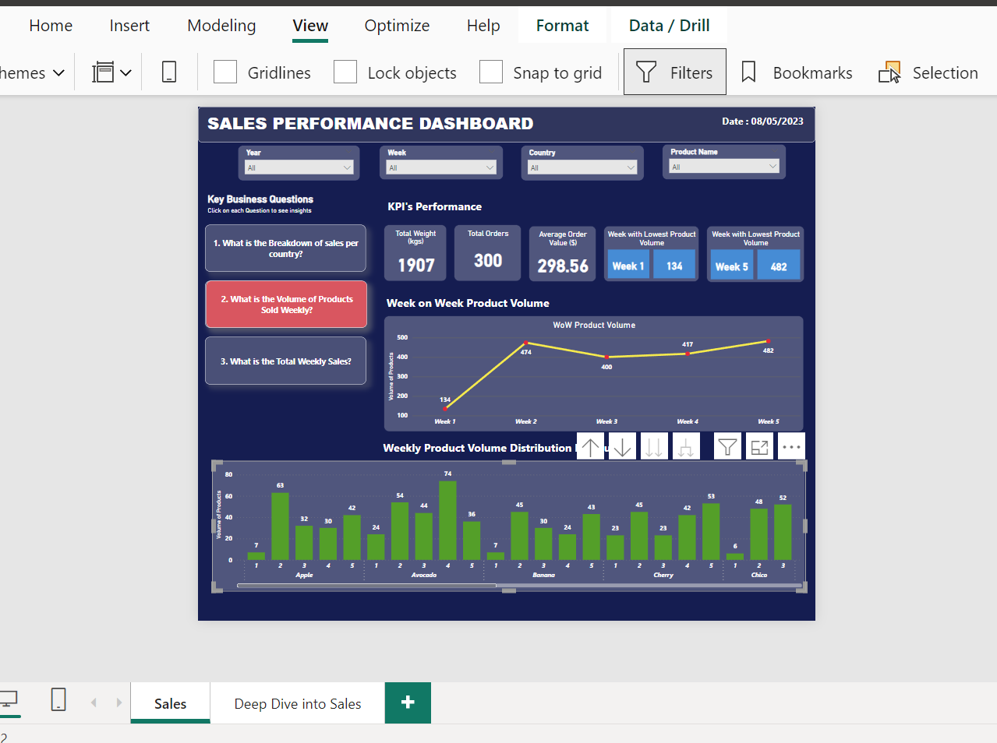
Dashboard

Slide 3
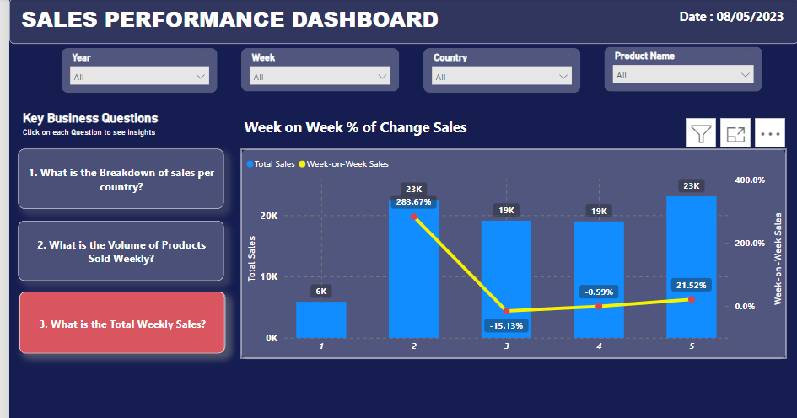
Dashboard

Slide 4
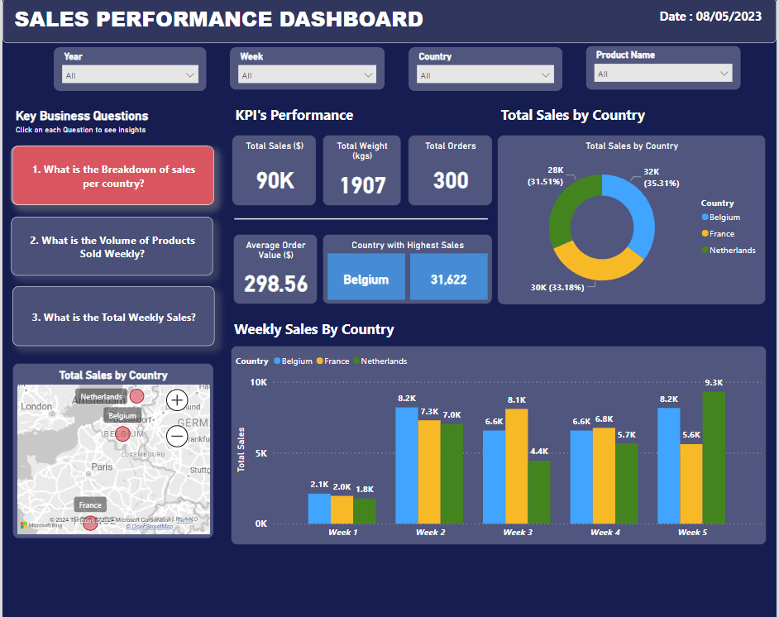
Dashboard

Slide 5
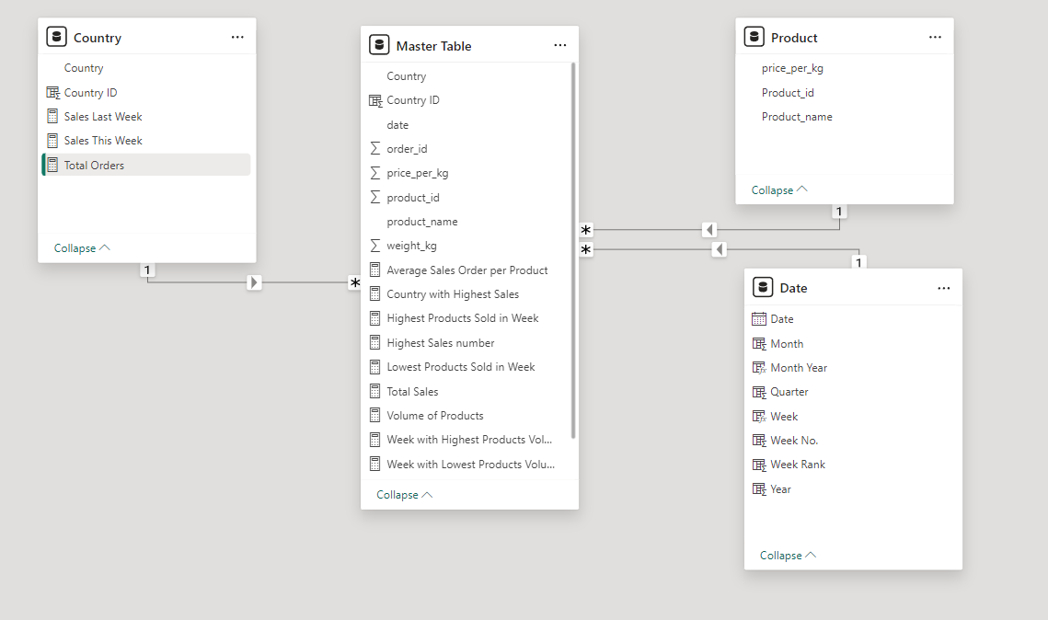
Data Model for Aggregated Data

Slide 6


Power BI DAX formulas

Slide 7



Slide 8



